Slide 1
Welcome to ACL Essentials
Enhance work quality | Reduce time | Concentrate on the highest risks

Slide 2
AGENDA
Objectives
What is in “ACL Essentials” Analysis Apps
Why is it a winning formula
Demonstration site access
Implementation approach

Slide 3
Our Mission

Slide 4

Creating a world where audit, risk & compliance professionals are an organization’s most sought-after people

Slide 5


Objectives
THE CUSTOMER (CFO/CAE)
Wants 100% Coverage of the business
Doesn’t have technical skills/understanding
Desires best-practise’s for maximum assurance
Looking for a solution, not just software
ACL/PARTNER
Wants a quick implementation
Maximise customer value for retention
Increase annuity revenue
Needs product differentiation

Slide 6
The Solution
ACL ESSENTIALS
PROCESS FOCUSSED
MULTI-ERP
PRE-DEFINED BEST PRACTISE ANALYTICS
MAXIMISE VALUE AND REVENUE

Slide 7
ACL Essentials Overview
Analysis Apps cover 13 business processes
Standardised on multiple ERP software solutions
Drives high value customer solutions
Achieves annuity revenue for ACL and its partners
Wizard driven implementation
Concurrent with ACL licensing (Launchpad)

Slide 8
Why is it a winning Formula?
Turns a software conversation into a SOLUTION SELL
Doubles or Trebles the analytics revenue
Customer understands the content more than the software
Drives annuity revenue
RESULT = 117 Installed Analysis Apps at Customers to-date
South America
USA
Africa

Slide 9
Essentials Apps Available

Slide 10
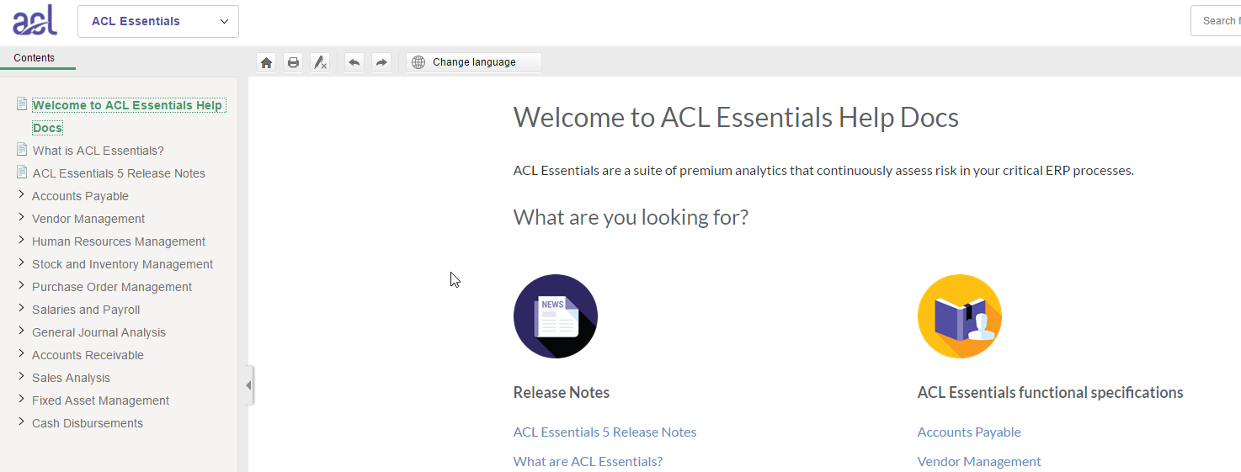
ACL Essentials Overview
Eleven modules
2 New Modules in March 17
SOD (Segregation of Duties – Key Activities)
T&E (Travel & Entertainment Expenses)

Slide 11

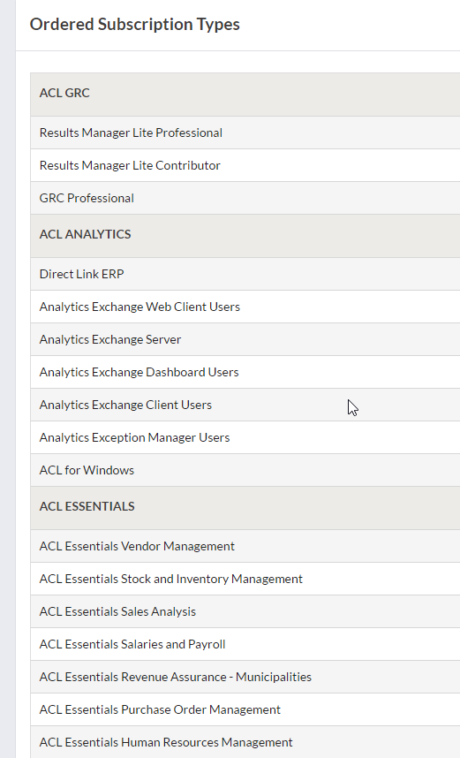
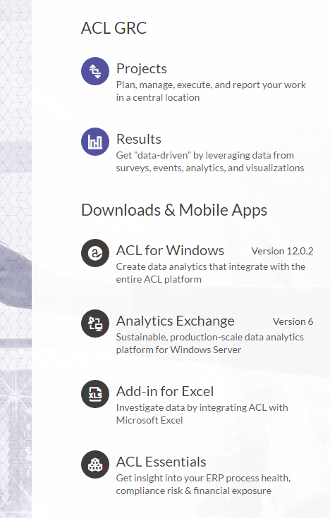
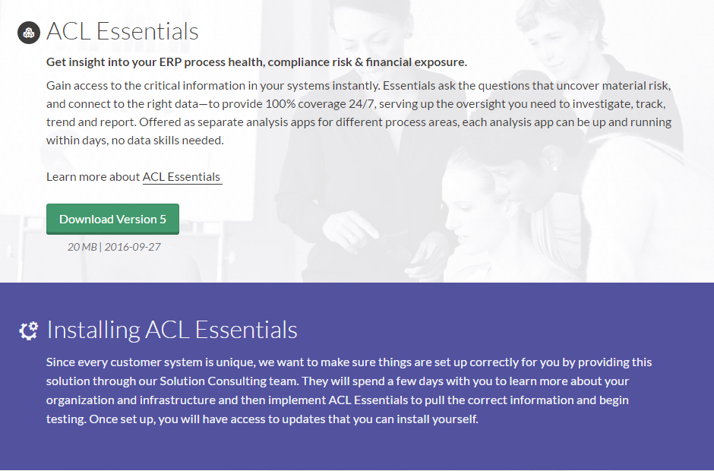
ACL Essentials on Launchpad

Slide 12
Demo Available Globally

Slide 13
ACL Essentials Demo
Global site hosted on AWS
Used in Sales demos
Refreshed/reset every morning at 3am (GMT)
Log in details:
User: PartnerDemo
Pass: Pass-123
https://demo.aclessentials.com

Slide 14
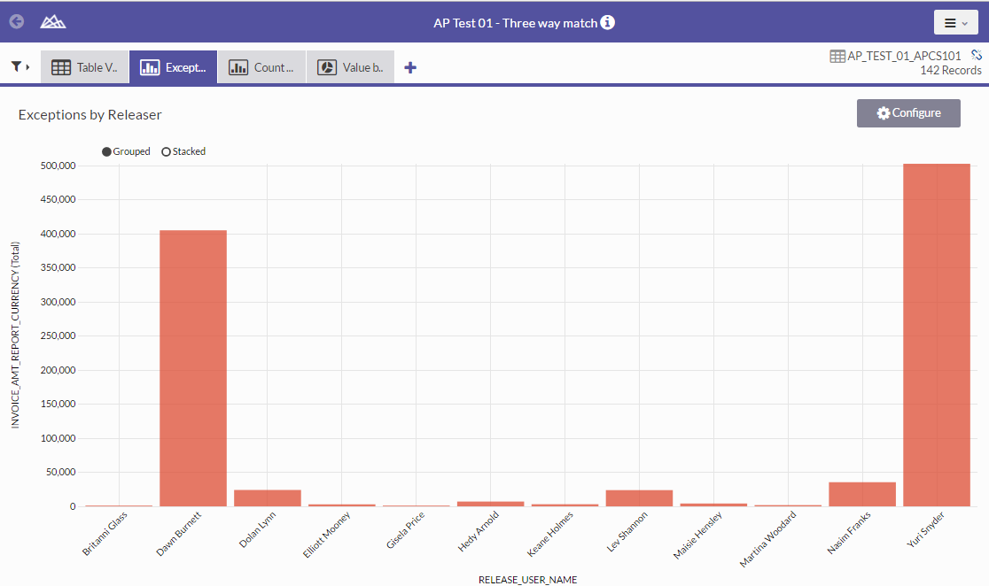
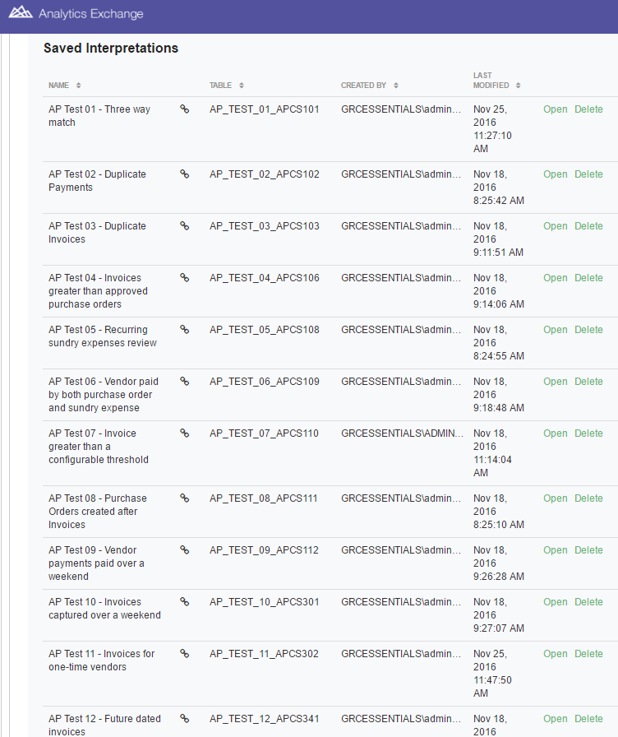
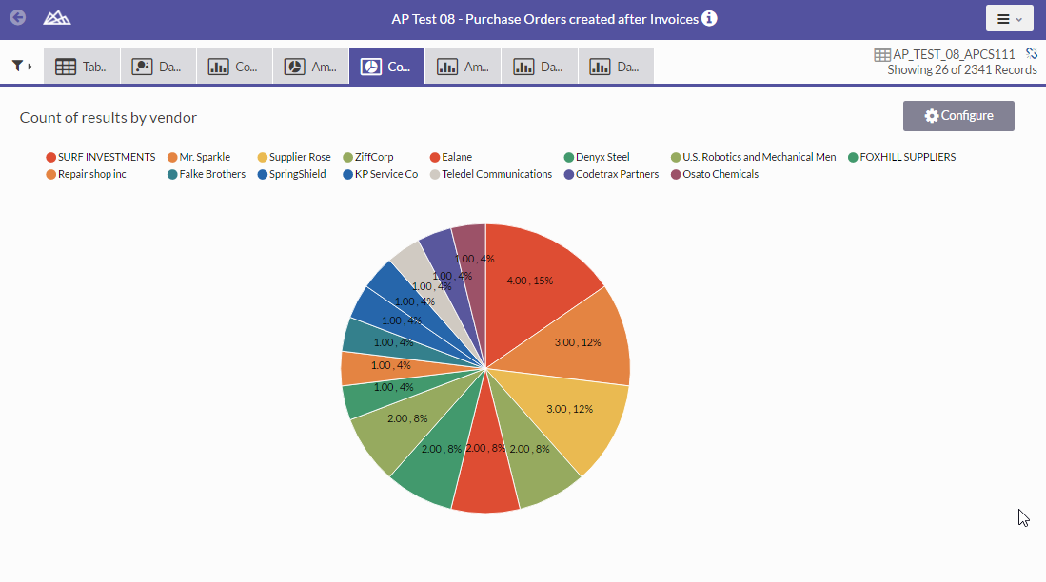
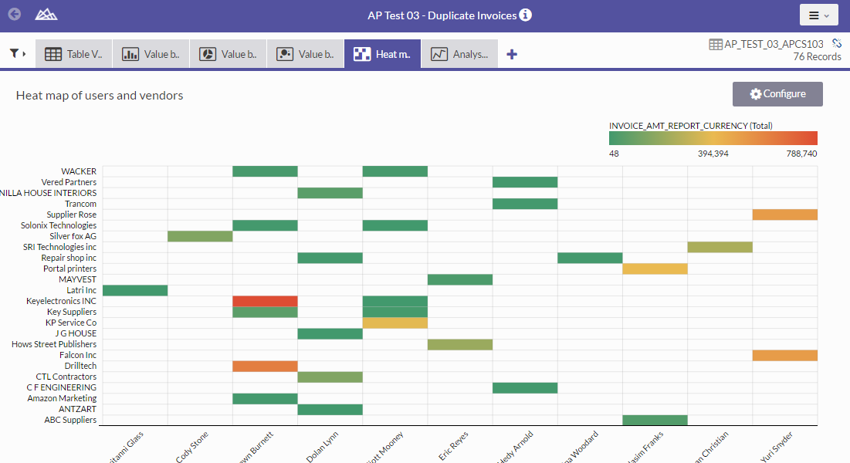
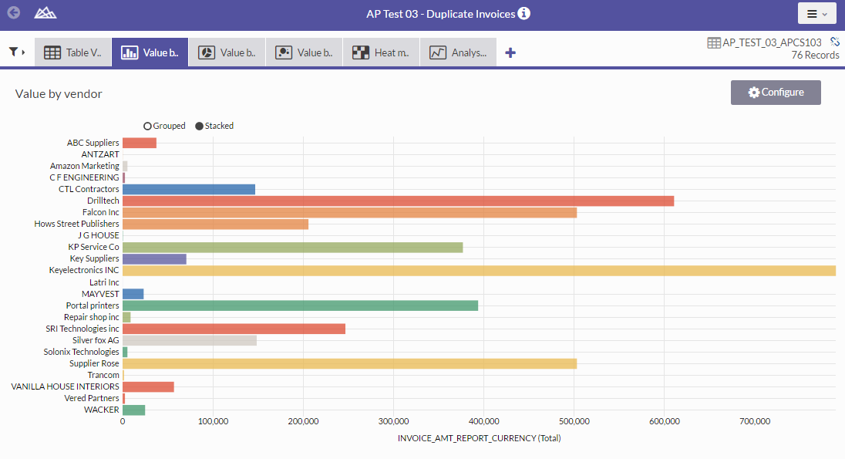
Multiple-Interpretations Ready to Demonstrate

Slide 15
ACL Essentials Documentation

Slide 16
ACL Essentials User Guide / Functional Specifications
http://enablement.acl.com/helpdocs/essentials/5/user-guide/en-us

Slide 17
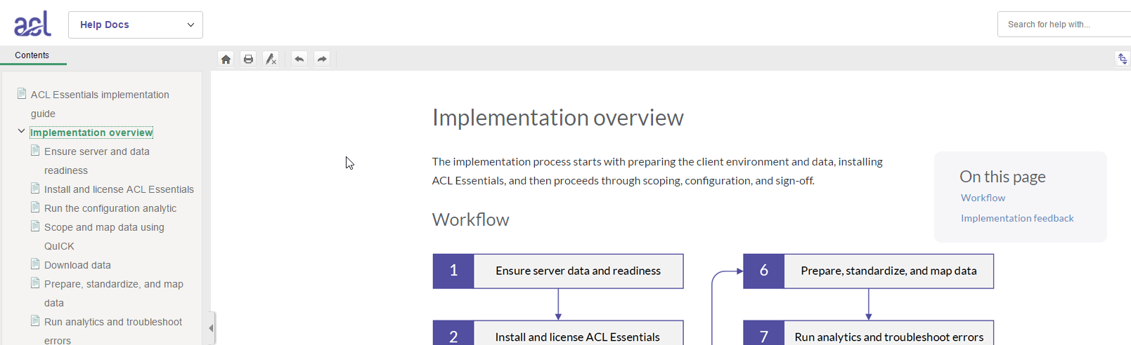
ACL Essentials Implementation Guide
Previously separate documents
Currently being consolidated into one online place
Link available to all consultants – not clients!
https://enablement.acl.com/_essentials/

Slide 18
ACL Essentials Implementation

Slide 19
High Level Implementation Process
Customer Readiness
Implementation
Review
Automate

Slide 20
Wizard-driven Approach using “QuICK”
Qu - Quick
I - Implementation
C - Configuration
K - Kit

Slide 21
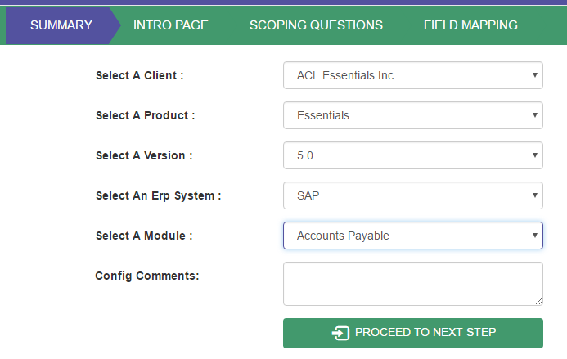
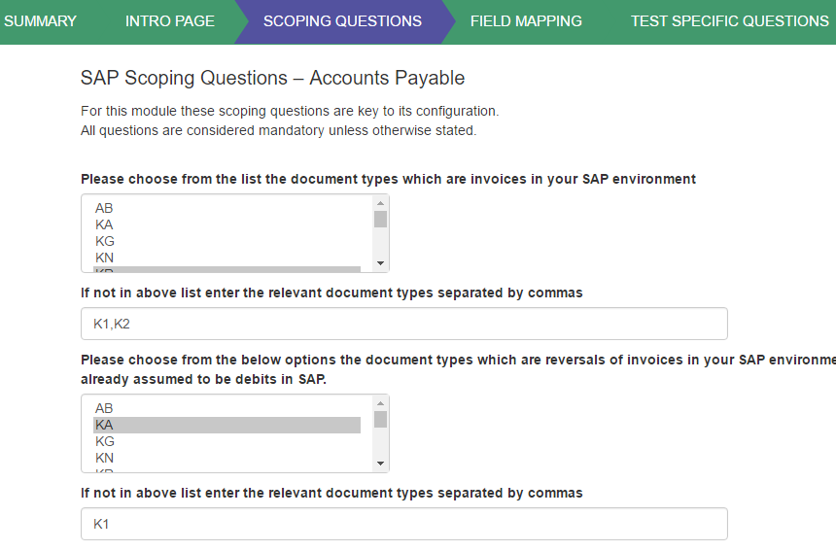
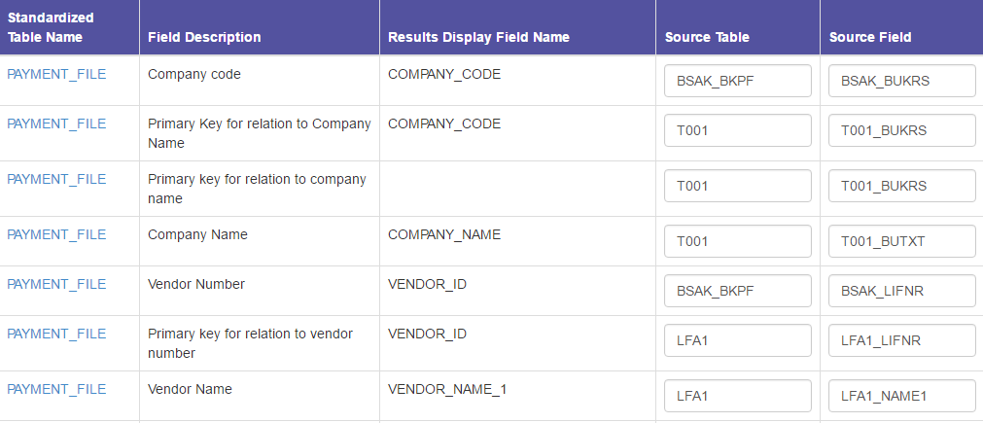
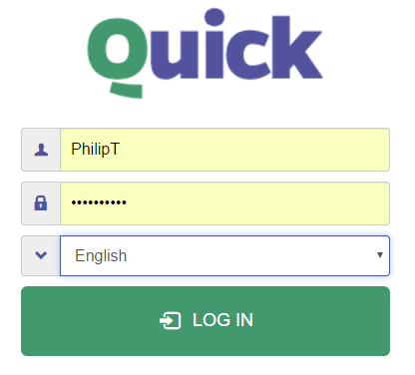
QuICK
Workflow Driven
ERP Specific Questions
Multiple Languages
Field Mapping

Slide 22
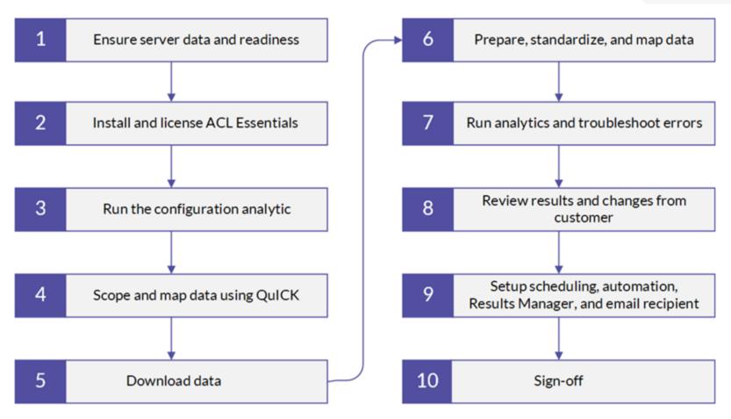
Detailed Implementation Process for a full project

Slide 23
POC approach with reference to Project steps
 | Step | Detail | Responsibility
A - Planning | Scope the POC | Before step 1 of server and data readiness POC Kick-off meeting and slides Identify which Essentials Module Identify which ERP System Pre-sending of mapping and scoping documents (step 6) | ACL Partner
A - Planning | Data Mapping and Scoping with client | Map the data fields Quicker if its SAP/Oracle/JDE Consultant uses QuICK | ACL Partner/CQS
B - Implementation | Configure Essentials | Steps 1, 2, 3, 5 and 6 Creating standardized tables in ACL Work effort depends on the ERP system | ACL Partner/CQS
B - Implementation | Run the Essentials | Execute the extraction and analysis Step 7 | ACL Partner
C - Review | Verify Results | Results file verification by consultant and client Step 7 and step 8 | ACL Partner/Customer
C - Review | Present Results | Present results and findings to the audit team using the standard POC presentation | ACL Partner

Slide 24
POC documents
POC sales deck
POC Kick-off slide deck
Planning document (from Phil)
Final results POC presentation slide deck

Slide 26
1. Server and Data Readiness, and ACL Software Installation
Underlying set up is done prior to commencement of the implementation
Often implementations are delayed because the client only begins setting up the server and the necessary log-ins when the consultant is onsite
This early delay will inevitably affect all subsequent milestones and deadlines
Scope definition (especially on out of scope items such as additional standardized fields)

Slide 28
2. Installation or Upgrades of Essentials and Licensing
Essentials version 5 is licensed through Launchpad and AX 6 (therefore is not compatible with prior versions of AX)
One orders Essentials licenses in the same way one orders ACL software
Installation: simple installation wizard, key to get match Unicode or non-Unicode versions to AX
Essentials 5 is ‘new’ to most markets and therefore no real upgrade issues right now
In future, we’ll be releasing similar timeframes to ACL if not more regularly
For upgrades requiring extra standardization and scoping, consultant time will need to be quoted as part of upgrade

Slide 30
3. Essentials Configuration Analytic in AX
Imported ACL Analytic Project
Creates the Essentials Analytic Projects for each of the modules using the language and country selection within the configuration
Always working on localizations and languages, welcome any feedback on this
Configures your environment (Error trapping variable, email details, single Excel file)

Slide 32
4. Scoping and Data Mapping using QuICK
Previously used Excel documents for mapping and scoping questions
Now all on online QuICK – the Quick Implementation Configuration Kit
Consultant-facing for now (will change end of March)
For SAP, it configures your data prep and standardization scripts
Takes away other manual scripting in the product – certain variables and features
Detailed User Guide just for QuICK
QuICK demo: https://quick.aclessentials.com/html/

Slide 33
4. Scoping and Data Mapping using QuICK
Log-ins and clients
New configuration
Types of pages
Saving configurations
Scoping sessions
Output: Config.QuICK file saved down in Essentials folder
Pdf output for record of scoping questions

Slide 34
4. Scoping and Data Mapping using QuICK
For SAP, it configures your data prep and standardization scripts
Takes away other manual scripting in the product – certain variables and features
Client's ERP?
SAP
Other
SAP QuICK
Custom QuICK

Slide 36
5. Data Downloads
Tables identified in scoping are to be downloaded
Available SAP Data Download projects
Date considerations are important for the validity of results and to ensure a smooth results review
Financial year end date
Fiscal period
Time period for audit
Date filters
SAP Payroll – extra effort because of lack of tables, detailed guidance on this and the SAP reports needed

Slide 38
6. Data Preparation, Standardization and Mapping
Source system folder
PRE folder for data preparation scripts
Main one is the B script where client’s data is standardized to 1 to 4 standardized tables applicable to a module e.g. invoice file
SAP QuICK vs Custom QuICK

Slide 39
ACL Essentials Structure
Connection to Client Data
Mapping to Standardised Table
PRE Scripts
Data validation of client data tables
Data prep
QuICK config variables
Definition of Standardised tables
Mapping variables
Field Order variables
Extraction filter variables
Standardized Tables
Essentials Analytic Logic and Licensing
DAT Scripts
Most Test Logic (or EF)
No Editing
COR Scripts
Encrypted
No Editing

Slide 41
7. Running Essentials Analytics and Troubleshooting
Set up of Source system and company name parameters in Essentials parameters before running the analytics
Running Essentials in AN / Desktop to assist with troubleshooting and investigating temp tables especially with Custom implementations
Raising any bugs or errors with ACL Support and it will be logged as a bug with CQS Product Team if need be
ACL analytic projects for multi-company SAP group of companies to help not manually capturing these

Slide 43
8. Results Review by Client
With Essentials being standardized, reviewing results should not be as intense as a Custom scripting project
Changes could be: changing the field order, extraction filters
Changes that should not be accepted are: changes in logic or adding brand new fields from new tables
Rather offer the client to give the suggestions to the Product Manager and it will be incorporated into the Essentials roadmap if similar request from other clients are received

Slide 45
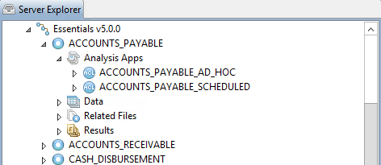
9. Scheduling, Automation, Results Manager and Email Recipient Set-up
Emailed exceptions vs Results Manager
Use QuICK for email recipients for test
Scheduling can be captured in QuICK, or use the Excel sign-off sheet
Scheduled (automatic dates) and Ad Hoc analytics available for client

Slide 47
10. Sign-off
Hard copy sign off with significant comments and extraction filters applied noted (Excel sign off document)
Error-trapping set back to False

Slide 48
QUESTIONS

